Slide 1
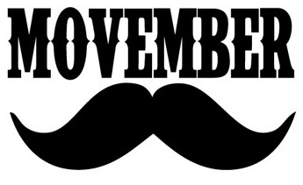

Northwest Men’s Health Defense Presents
The 10th Annual Movember Charity Classic
September 2022
Match Booklet

Slide 2
Movember Charity Classic
In 2012 I partnered with my friend Alan Fuecht, after my Prostate cancer battle; and together we created a 501c charity named Northwest Men’s Health Defense. NMHD hosts a yearly charity event named the Annual Movember Charity. This is a charity event in the form of hybrid action pistol shooting match, marrying the action pistol sports USPSA and IDPA rules adn unique. All match proceeds go to the Movember Organization [https://movember.com/] and Prostate Cancer Foundation[http://pcf.org] . Since the charity’s conception and the generosity of the PNW action pistol shooting family; together we have raised thousands of dollars for medical research, patient support, and awareness programs that have benefited thousands of men that struggle with this cancer.
The event brings together shooters from both disciplines to enjoy a shooting match incorporating rules from both sports to create a match that is challenging and fun.
Prostate Cancer is a deadly cancer, yet quite survivable, with early detection, afflicting men each year. So far In 2022 there have been approximately 249K men who have contracted the disease with a sobering 34K dying from the disease so far this year.
We here at NMHD encourage you to get engaged in your Prostate health. Please work with your doctor, and start a yearly Prostate screening program as soon as possible.

Slide 3
Match Schedule
0700 Action Bays Open
0730 Registration Opens
0830 Stage Walk Through
0850 Shooter’s Meeting
0900 Match Starts
1500 Approx. Match Concludes
1500 Approx. Stage Tear Down
1600 Approx. Awards Presentation
1630 Action Bays Closed

Slide 4
Match Format
Action Pistol Match
7 stages including lots of steel
7 divisions
Carry Optics
PCC
SSP & Production (mags loaded to 10 + 1 loaded chamber start)
ESP & Limited (mags fully loaded)
Open
Single Stack/CDP (.45 ACP only)
Revolver
Most divisions translate 1:1, but some don't. Note: ESP is fully loaded mags. SingleStack/CDP is 45ACP only, but not necessarily a 1911 design. There is no CCP or BUG. you won't have enough mags for this match and will find more enjoyment in the higher cap divisions.
IDPA targets
IDPA scoring rules with electronic scoring with PractiScore
USPSA equipment rules
USPSA stage design philosophy and rules
https://practiscore.com/movember-2021/register

Slide 5
Movember Scoring For Competitors
The match incorporates the IDPA targets and IDPA scoring; and USPSA rules regarding gear management and stage execution.
We will be trying a slightly modified method of scoring for this match called TimePlus/w Points.
This does not change how you score a stage. It is still conventional IDPA -0, -1, -3, Noshoot-5, PE -3, etcetc.
HOWEVER, this changes how the overall match results are calculated.
In IDPA, each stage final time is added together and that's your final score for the match.
This means a no-shoot and a PE or two on a stage haunts you for the rest of the match and has significant impacts on your final score.
With the "Points" system, this effect is diminished.
Your TimePlus score for the stage is ranked against everybody else in your division and you are assigned a percentage based on the fastest(lowest time) finish on that stage.
Each stage is worth 100 points and you receive points based on your percentage for each stage.
At the end, your points are added together and that's your match finish.
Thus, a noshoot on stage 1 will impact how many points you get for stage 1, but the effect of that noshoot on the final score is softened

Slide 6
For ROs: Movember Scoring Rules 101
Movember is IDPA scoring. Also known as “time plus” scoring.
Hits on target
-0, no time added
-1, one second added
-3, three seconds added
each complete miss, five seconds added per miss
There are NO OVERLAYS. If you stare at a target longer than 2 seconds the score goes in favor of the shooter. Unwitnessed perfect doubles will be scored 1 hit, 1 miss.
Pass thru shots are scored on any scorable target
Every shot on a no shoot is scored
No cover garment is required
Reloading can be done at any time during the course of fire, magazines do not need to be empty and do not need to be retained.
All-steel stage: Full hit on steel that doesn’t fall is considered a hit. Adjust the steel for the next shooter and keep an eye on it.
Penalties,
Procedural Penalties, 3 seconds, given for not following the rules
Foot faults, 1 procedural per position unless otherwise noted
Remember this is a charity match. The goal is to raise money for cancer awareness and to have fun while doing so.

Slide 7
Special Thanks
Food Provided By
Mobile Mayan
https://www.mobilemayan.com/#Menu-1
Auction Table Provided By
Pantel Tactical
Range Facilities Provided By
Renton Fish & Game Club
Keith Tsang
Alan Fuecht
Chris Pukalo
Marcel Englmaier
Eric Beerbaum

Slide 8
Stage 1
Recall of Duty
Course Designer: Chris Pukalo
Recall of Duty is a 50 round course. There are 25 IDPA targets. The best two hits per target will score. The start signal is audible.
The Handgun start position is standing with heels touching marks with wrists below belt. Handgun loaded and holstered.
The PCC start position is standing with heels touching marks. PCC loaded, stock on belt, safety on.
On the audible start signal, engage targets from within the shooting areas.
Notes:
‹#›

Slide 9
Stage 1
Recall of Duty
Course Designer: Chris Pukalo
XX

Slide 10
Stage 2
Who The Hell Did This
Course Designer: Chris Pukalo
Who The Hell Did This is a 24 round course. There are 12 IDPA targets. The best two hits per target will score. The start signal is audible.
The Handgun start position is standing with heels touching marks with wrists below belt. Handgun loaded and holstered.
The PCC start position is standing with heels touching marks. PCC loaded, stock on belt, safety on.
On the audible start signal, engage targets from within the shooting areas.
Notes:
‹#›

Slide 11
Stage 2
Who The Hell Did this
Course Designer: Chris Pukalo
xx

Slide 12
Stage 3
Coulda Been Somebody
Course Designer: Marcel Englmaier
Coulda Been Somebody is a 40 round Pro-Am Par Time course. There are 32 Steel targets. The poppers must fall to score. The static square steel require 2 hits to score. The par time is 45 seconds. Any hits overtime(0.31s or more after the par time beep) will be considered a miss and time will be recorded as 45s. The start signal is audible.
The Handgun start position is standing completely outside any shooting area with wrists below belt. Handgun loaded and holstered.
The PCC start position is ding completely outside any shooting area. PCC loaded, stock on belt, safety on.
On the audible start signal, engage color-coded targets from within the respective shooting areas.
Times faster than 40 seconds will be recorded, otherwise you get 40 seconds due to PAR. Any full-diameter hit will count if steel does not fall. Steel left standing or static steel without 2 hits = 1 miss per occurrence.
Notes:
‹#›

Slide 13
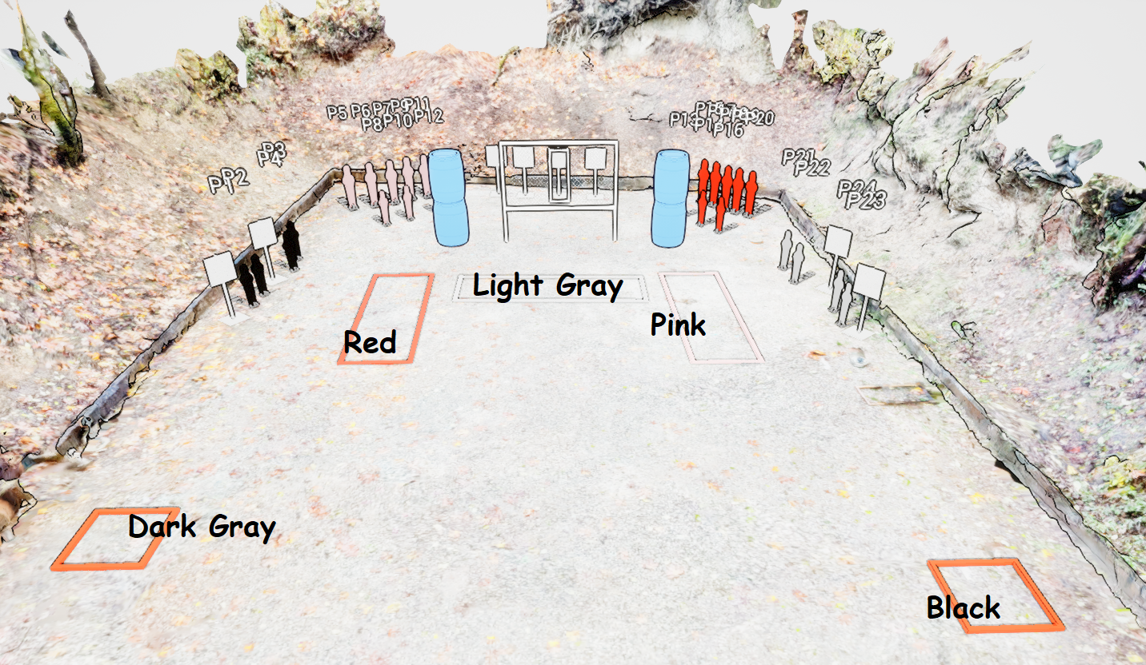
Stage 3
Coulda Been Somebody
Course Designer: Marcel Englmaier

Slide 14
Stage 4
Press F To Hose Respects
Course Designer: Eric Beerbaum
Press F To Hose Respects is a 38 round course. There are 19 IDPA targets. The best two hits per target will score. The start signal is audible.
The Handgun start position is standing with one hand touching tree and the other hand holding F above shoulders. Handgun loaded and holstered.
The PCC start position is muzzle touching tree with strong hand holding F above shoulders. PCC loaded, stock on belt, safety on.
On the audible start signal, engage targets from within the shooting area.
Notes:
‹#›

Slide 15
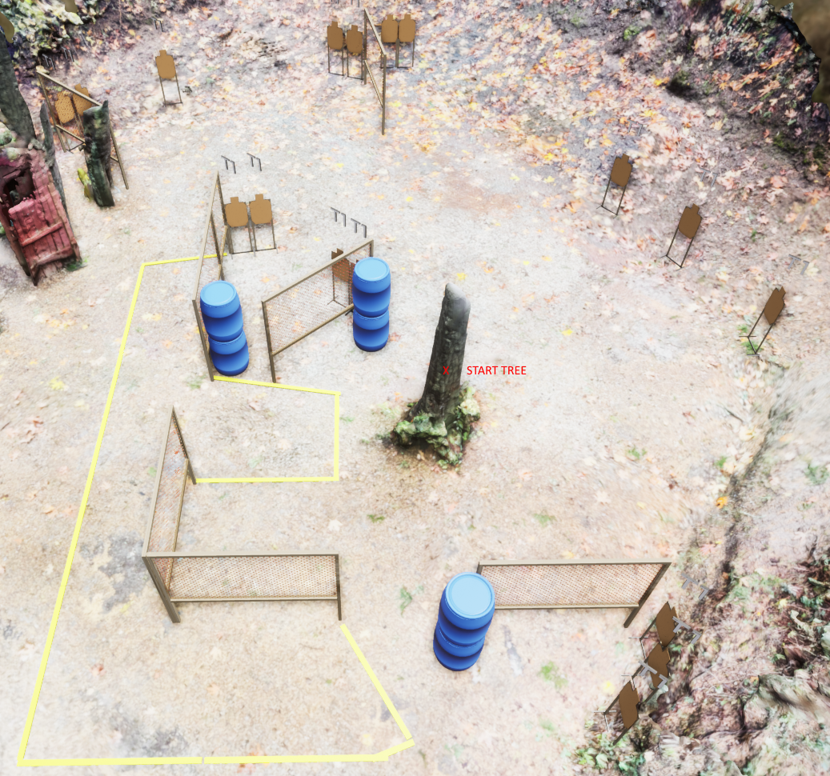
Stage 4
Press F To Hose Respects
Course Designer: Eric Beerbaum

Slide 16
Stage 5
They Told Me This Was A Hoser Match
Course Designer: Eric Beerbaum
They Told Me This Was A Hoser Match is a 28 round course. There are 14 IDPA targets. The best two hits per target will score. The start signal is audible.
The Handgun start position is standing completely outside the shooting areas with wrists below belt. Handgun loaded and holstered.
The PCC start position is standing completely outside shooting areas. PCC loaded, stock on belt, safety on.
On the audible start signal, engage targets from within the shooting areas.
Notes:
‹#›

Slide 17
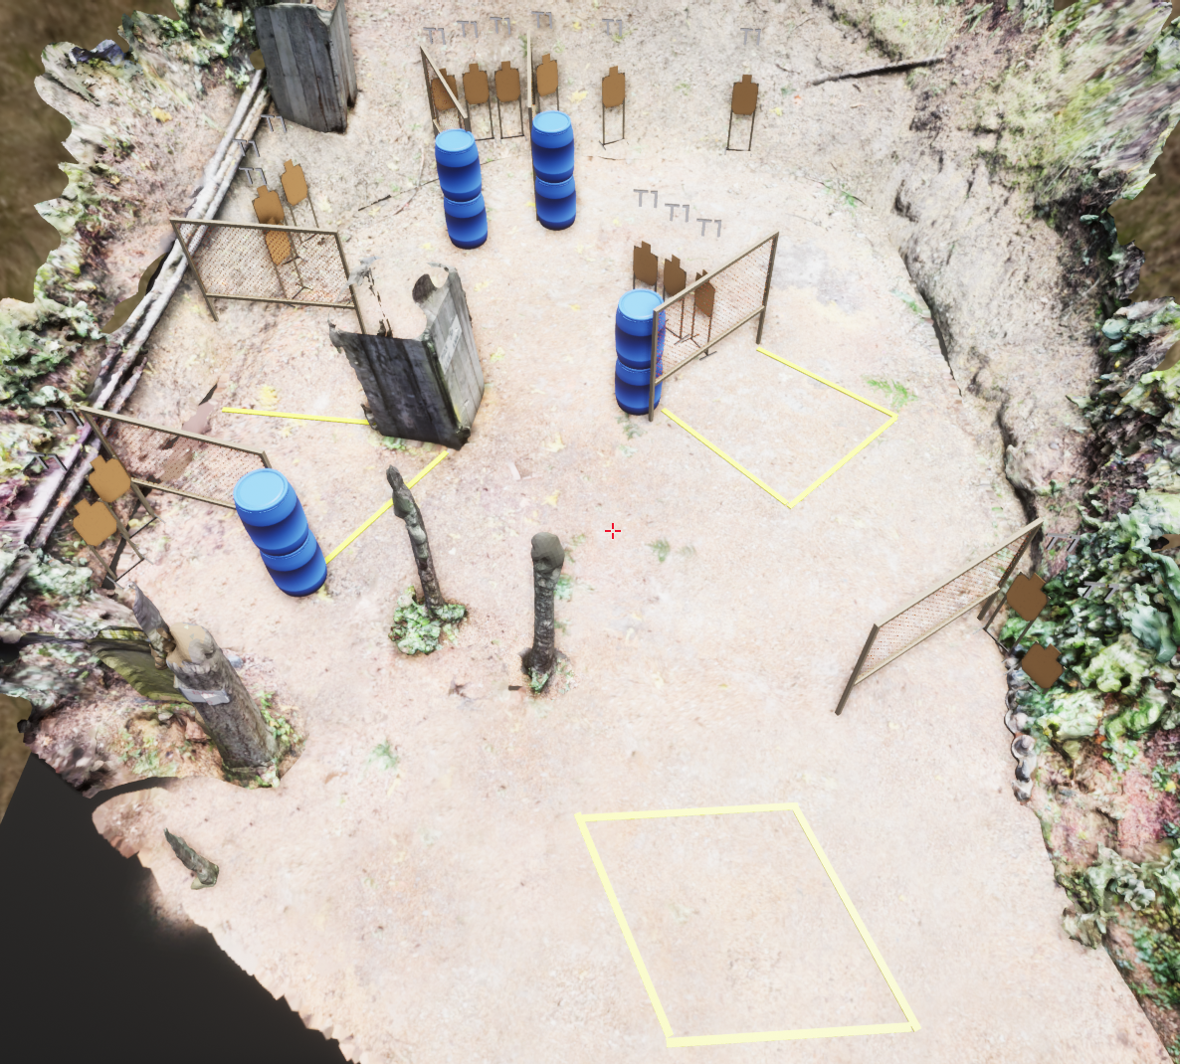
Stage 5
They Told Me This Was A Hoser Match
Course Designer: Eric Beerbaum

Slide 18
Stage 6
Barrel of Monkeys
Course Designer: Dave McClure
Barrel of Monkeys is a 44 round course. There are 22 IDPA targets. The start signal is audible
The Handgun start position is standing completely outside any shooting area with wrists below belt. Handgun loaded and holstered.
The PCC start position is ding completely outside any shooting area. PCC loaded, stock on belt, safety on.
On the audible start signal, engage targets from on top shooting areas. Shots fired while not on shooting areas incur 1 penalty per shot fired.
Notes:
‹#›

Slide 19
Stage 6
Barrel of Monkeys
Course Designer: Dave McClure
Tree
Tree
Tree
X

Slide 20
Stage 7
What the Dickens, Dickens, Dickens
Course Designer: Chris Pukalo
What the Dickens, Dickens, Dickens is a 24 round course. There are 6 IDPA targets. The best four hits per target will score. The start signal is audible.
The Handgun start position is standing completely outside any shooting area with wrists below belt. Handgun loaded and holstered.
The PCC start position is ding completely outside any shooting area. PCC loaded, stock on belt, safety on.
On the audible start signal, engage targets from within the shooting areas.
Notes:
‹#›

Slide 21
Stage 7
What the Dickens, Dickens, Dickens
Course Designer: Chris Pukalo

